Slide 1
Cone Orienteering
EQUIPMENT (I have just halved a normal class size)
15 cones
15 maps (if you laminate them, they can be disinfected)
15 clipboards
15 pencils
15 answer sheets (if you laminate them, you will save paper BUT then each child will need a whiteboard pen)
15 numbers/fruits (laminated)
PREPARATION
Set out the 15 cones with numbers OR fruits taped onto them. **You need to know the grid references where you have placed the cones**
Hand out a clipboard with map, answer sheet and pencil to each child. (If the maps are laminated, they won’t need a clipboard)
TASK 1
Discuss how to hold the map
Ask them what grid they are standing in as you are talking to them
Make them move to another grid reference
On your command, they have to find each cone
When they find cone number 1, they insert the grid reference next to number 1 on the answer sheet
Discuss – correct grid references, success, how to improve?
EXTENSION
What is the total of all the numbers? – 120

Slide 2
TASK 2
If you are doing this in the same lesson, you will need to flip the cards over (from number to fruit)
Using the same answer sheet as for the previous task
Repeat task and find out which fruit is at each cone
Before setting out, ask them to think of a plan of attack – they will have grid references, so might want to decide what order to visit the cones
EXTENSION
How many words can you make from the 1st letter of each fruit?
Have they spelt each fruit correctly?
TASK 3 – you cannot do this in the same lesson as task 1 & 2
Put a letter on each cone
Children have to find all the letters (eg MIERSCOURTSCHOOL)
You could give them the grid references of the cones OR just let them run and find them,

Slide 3
PREPARATION BEFORE LESSON
Take a photo of your school grounds - I used google maps
Add grids on top of the map and include the axis – along the corridor and up the stairs
Print off the numbers and fruits
Put them back to back so that 1 is behind the blackberries
Laminate and cut out
REMIND THE PUPILS
Only one person is allowed to touch the cones
Only one person is allowed to touch the laminated number/fruits
Only one person is allowed at a cone – anyone else must wait until the 1st person has moved away
At the end of the lesson, answer sheets pens and maps are put in a box (ready for disinfecting)

Slide 4
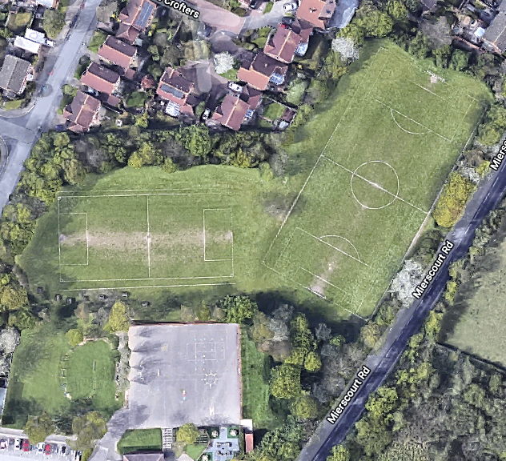

10
9
8
7
6
5
4
3
2
1
 | A | B | C | D | E | F | G | H | I | J
HOW TO READ A GRID REFERENCE: -
go along the corridor
(horizontal, x axis, eastings)
and then up the stairs
(vertical, y axis, northings).
Y
X

Slide 5
TASK 1
TASK 2
TASK 1
TASK 2
 | GRID REFERENCE
1
2
3
4
5
6
7
8
9
10
11
12
13
14
15
16
 | GRID REFERENCE
1
2
3
4
5
6
7
8
9
10
11
12
13
14
15
16

Slide 6
TASK 1
TASK 2
How many words can you make using these letters?
BGPBPRCWAOSPPTPK
KNOT
GOAT
BOAT
PANT
GNAT
BAT
PAT
GOT
COAT
CAT
COT
RAT
ROT
POT
SAT
NOT
BARK
BACK
CROW
SCAB
CARP
WASP
TRAP
STOP
SPOT
 | GRID REFERENCE | FRUIT
1 | C1 | BLACKBERRY
2 | J8 | GRAPES
3 | E1 | PINEAPPLE
4 | F7 | BANANA
5 | E4 | PLUM
6 | D2 | RASPBERRIES
7 | I6 | CHERRIES
8 | H9 | WATER MELON
9 | E3 | APPLE
10 | F6 | ORANGE
11 | C7 | STRAWBERRY
12 | B3 | PEAR
13 | C2 | POMEGRANATE
14 | A3 | TOMATO
15 | C4 | NECTARINE
16 | B2 | KIWI

Slide 7
1
2
3
4
5
6
7
8

Slide 8
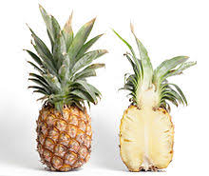
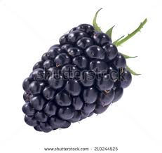
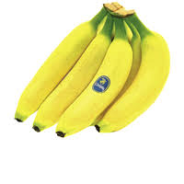

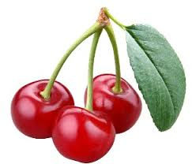
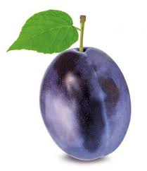
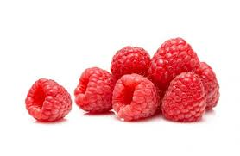
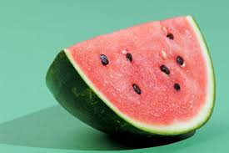

Slide 9
9
10
11
12
13
14
15
16

Slide 10
